Slide 1
PRACTICAL 23
Generative AI for Beginners
A student's guide to understanding and using artificial intelligence.

Slide 2
What exactly is Generative AI?

Slide 3
The Evolution of AI
Traditional AI
Generative AI
Analyzes existing data.
Creates entirely new content.
Recognizes a cat photo.
Draws a brand new cat.

Slide 4




CAPABILITIES
Multimodal Generation
Text Generation
Image Synthesis
Written language synthesis.
Photorealistic visual rendering.
Audio Creation
Video Production
Original music composition.
Motion graphic sequences.

Slide 5


MECHANISM
Massive Pattern Recognition
Models predict subsequent components based on extensive training datasets.

Slide 6



Real-World Tools
ChatGPT
Midjourney
GitHub Copilot
Conversational text generation.
High-fidelity image synthesis.
Software programming assistance.

Slide 7
Unprecedented Adoption
100M
ChatGPT users reached in initial two months.

Slide 8
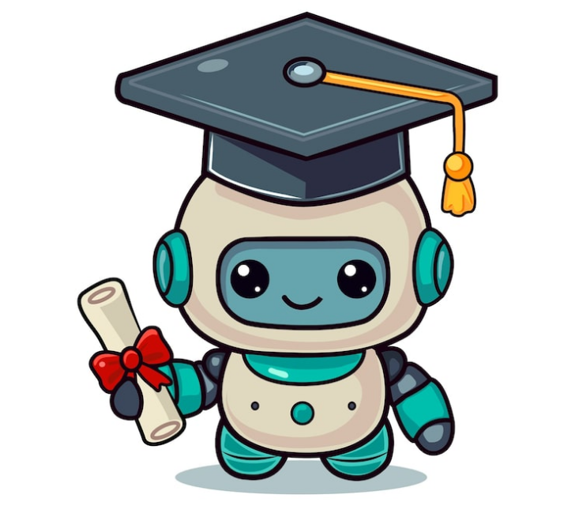
Your Digital Co-Pilot
Human oversight guarantees optimal outcomes.

Slide 9
Responsible Utilization
Fact Verification: Validate critical assertions independently.
Data Security: Exclude personal identifying information.
Human Refinement: Personalize synthetic outputs.
Academic Integrity: Enhance learning methodologies legitimately.

Slide 10

Ready to Explore?
Questions & Discussion

Slide 11


Image Sources
https://img.magnific.com/free-vector/abstract-pyramide-wireframe-background_1017-8200.jpg?semt=ais_hybrid&w=740&q=80
Source: www.magnific.com
https://img.magnific.com/premium-vector/robot-online-courses-modern-education_546559-3254.jpg?semt=ais_hybrid&w=740&q=80
Source: www.magnific.com

